Slide 1
Software Defined Networking
OpenFlow
Notes:
What SDN is and how it differs from traditional networking.
The role of OpenFlow in SDN.
How SDN enables centralized control, automation, and security improvements.
Practical use cases, including load balancing, routing, security, and monitoring.

Slide 2
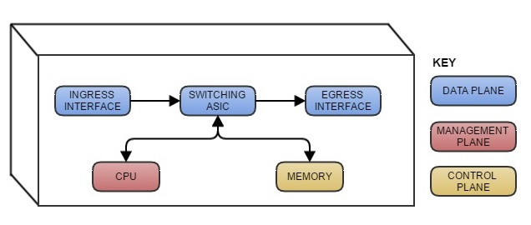
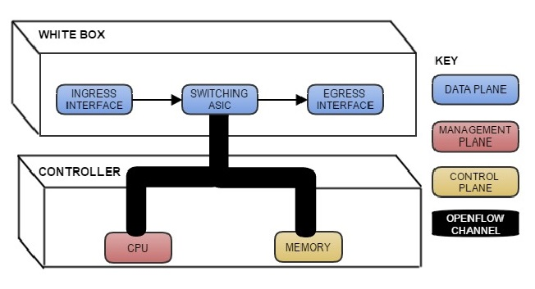
Traditional Switch
SDN Switch
Notes:
ASIC = Application-specific integrated circuit
Traditional switches make up a hardware-defined network
Managed switches use STP (Spanning Tree Protocol) to prevent loops and MAC address tables to forward frames to the correct destination
Regular switches
Complex management – Admins must configure each switch manually.
Inefficiency in large networks – Harder to scale dynamically.
Static traffic routing – Cannot easily adapt to traffic spikes or security threats.
SDN switches refer to the SDN controller for instructions
Centralized management – One controller makes all network decisions.
Faster troubleshooting – Admins can modify the network dynamically.
Improved security – SDN can instantly block malicious traffic at the switch level.

Slide 3
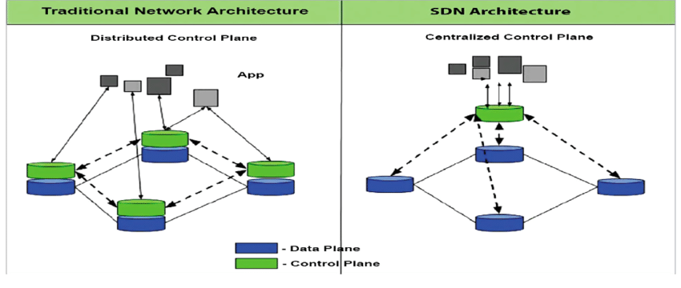

Slide 4
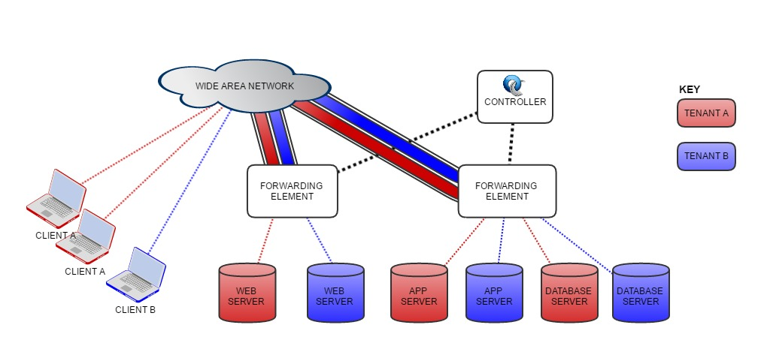
Use Cases
Load Balancing
Routing
Packet-level Metrics
Intrusion Detection
Notes:
1. Load Balancing
Problem in Traditional Networks: Load balancers distribute traffic based on predefined rules, often causing bottlenecks in busy servers.
SDN Solution: Dynamically distributes traffic based on real-time server load and network congestion.
2. Routing Optimization
Problem in Traditional Networks: Routing protocols like OSPF (Open Shortest Path First) and BGP (Border Gate Protocol) take time to converge when links fail.
SDN Solution: The controller dynamically updates routing tables in real-time, avoiding latency and downtime.
3. Packet-Level Metrics & Network Monitoring
Traditional SNMP-based monitoring is slow and lacks granularity.
SDN gathers real-time flow-level data, making anomaly detection faster and more efficient.
4. Intrusion Detection & Security
Traditional networks rely on firewalls placed at specific points.
SDN applies security policies at the switch level, blocking malicious traffic before it reaches sensitive systems.

Slide 5
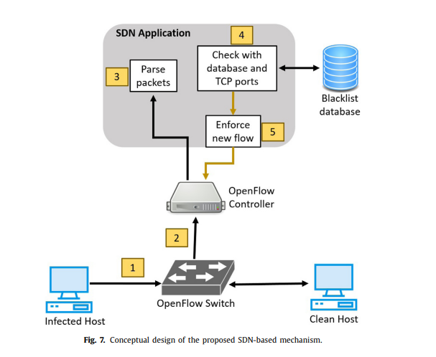
Notes:
OpenFlow is the first and most widely adopted SDN protocol.
Enables direct communication between an SDN controller and OpenFlow-enabled switches.
How it works:
The controller dictates flow rules instead of each switch making decisions.
Flow rules define how packets are forwarded, modified, or dropped.
Analogy:
Traditional network: Like traffic lights with fixed timers (static rules).
SDN/OpenFlow: Like a smart traffic control system that adjusts signals in real-time based on congestion.

Slide 6
OpenFlow
Relies completely on the controller for forwarding
Flow Table - Performs packet look-ups
Match Fields - Headers, ingress and metadata
Counters - collects statistics for a flow
Actions - Applies to a match
Priority - Priority of flow entries
Timeouts - How long a flow entry should last
Cookies - Used to filter flow entries
Flags - Alter the way flows get managed.
Notes:
Match Fields – Identify packets based on criteria (IP, MAC, VLAN, TCP/UDP).
Counters – Track the number of packets/bytes for each flow.
Actions – Define what happens to matching packets (forward, modify, drop).
Priority – Higher-priority rules are executed first.
Timeouts – Rules expire based on usage or fixed duration.
Cookies – Help track specific flow entries.
Flags – Modify flow table behavior (e.g., sending updates to the controller).

Slide 7
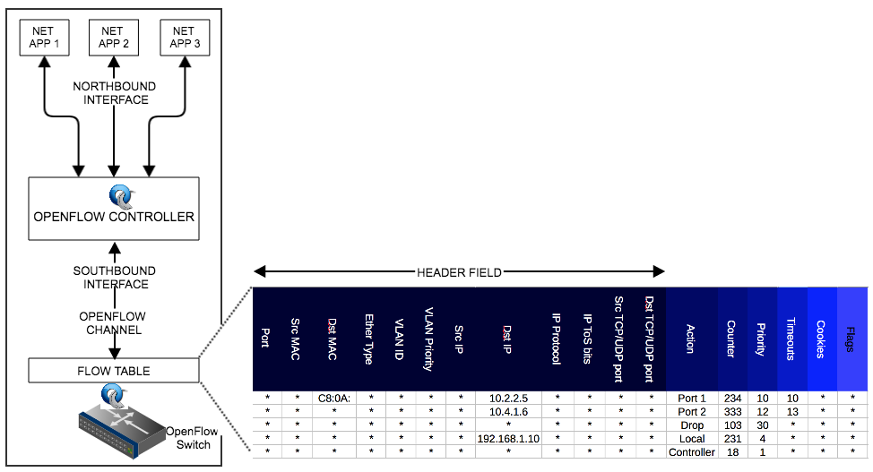
Header

Slide 8
Actions
Required Actions
Forward
ALL
CONTROLLER
LOCAL
TABLE
IN_PORT
Drop
Optional Actions
Forward
NORMAL
FLOOD
ENQUEUE
Modify Field
VLAN_ID
ETH_SRC or ETH_DST
TCP\UDP
Notes:
REQUIRED:
ALL – Send the packet to all ports (except the incoming one).
CONTROLLER – Send the packet to the SDN controller.
LOCAL – Deliver it to the switch’s local stack.
TABLE – Process the packet further in another flow table.
IN_PORT – Send it back to the port it came from.
OPTIONAL:
NORMAL – Uses traditional MAC-based forwarding (like a standard switch).
FLOOD – Sends packets to all ports except the incoming one.
ENQUEUE – Places packets in a queue for Quality of Service (QoS) control.
VLAN ID – Used for dynamic VLAN assignment.
ETH_SRC / ETH_DST – Can rewrite MAC addresses.
TCP/UDP – Enables SDN-based firewalling and traffic redirection.

